Slide 1
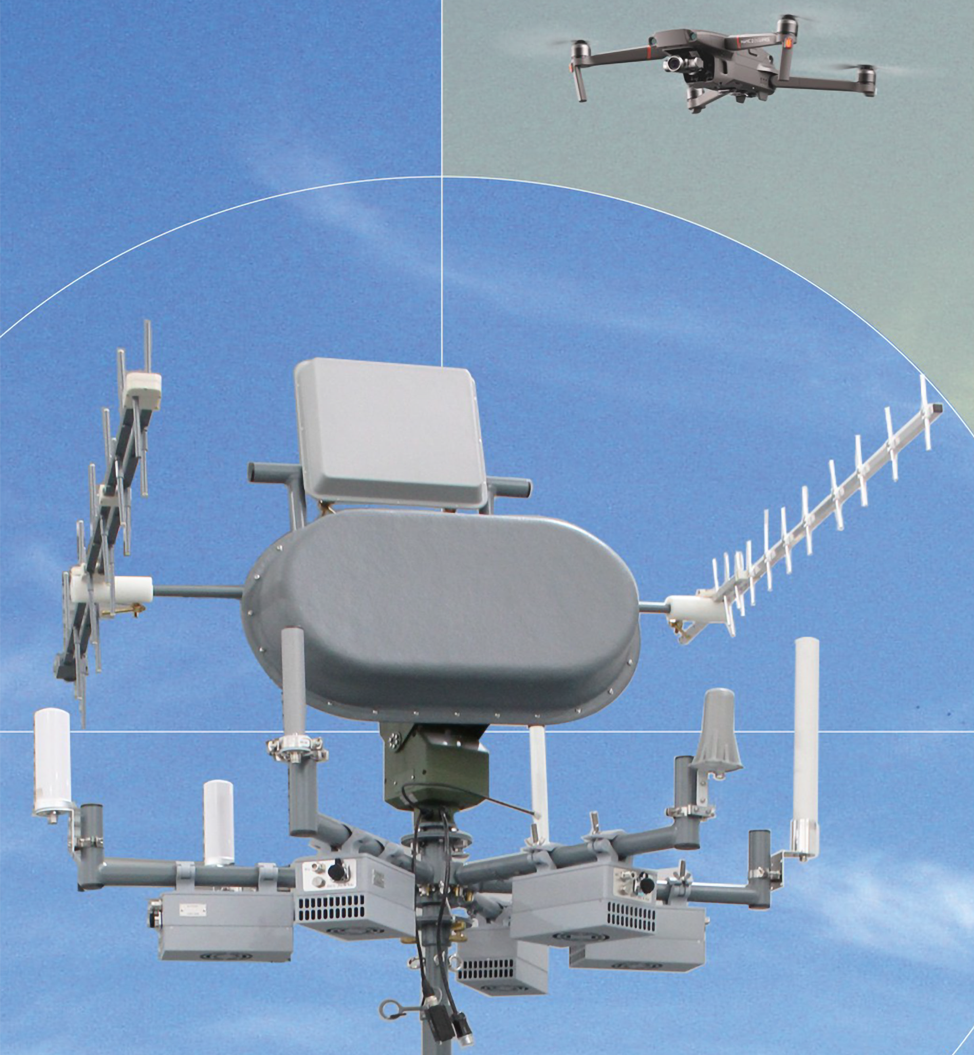
MOBILE
ANTI-DRONE
SYSTEM
(SIMAD)
2025
SIMAD tested and certified specifications are placed among the best military counter-drone
devices worldwide

Slide 2
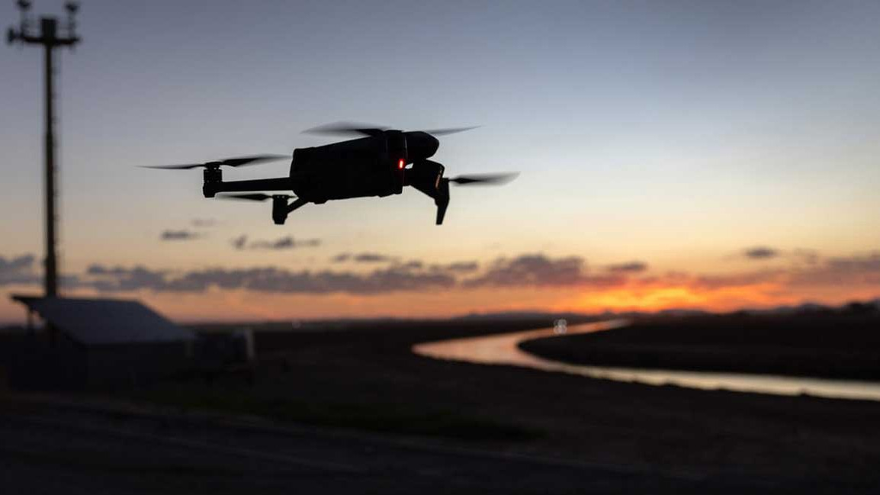
ADVANTAGES
THE ONLY MILITARY GRADE SOLUTION IN THE MARKET
WITH
NO EXPORT RESTRICTIONS
SIMAD is undetectable, emiting no radiation.
Its versatility allows for variable combinations and configurations depending on the mission.
It can be dimensioned to enemy’s capabilites, eliminating threats without consuming ammunition.

Slide 3
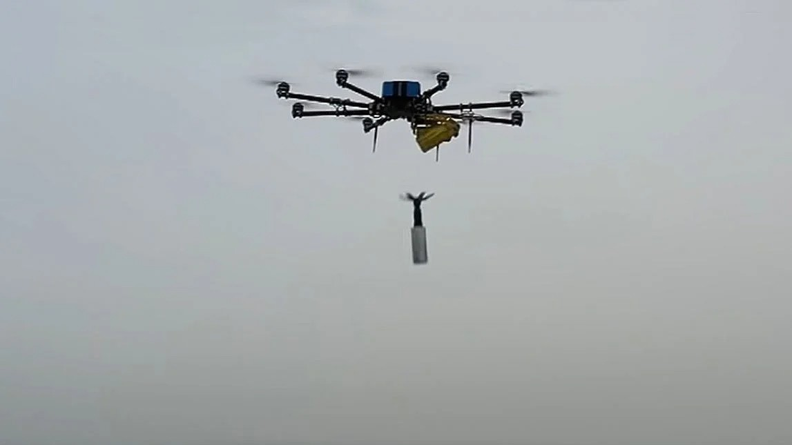
HIGHLIGHTS
Operation autonomy in mobile installation (vehicle): depending only on external power supply.
Can operate without intervention, depending on its configuration.
Capable of operating in adverse weather conditions. Operates in various bands and frequency ranges.
High-quality processing of raw data by the integrated proprietary software.
Few requirements for personnel training to operate the system.
High operational efficiency compared to other sys- tems.
Tracking device for mobile and stationary targets, de- termining the direction of the targets (using a radar system).
Fully automatic Command and Control System.
Can be mounted on civilian and military vehicles or installed in fixed buildings.

Slide 4
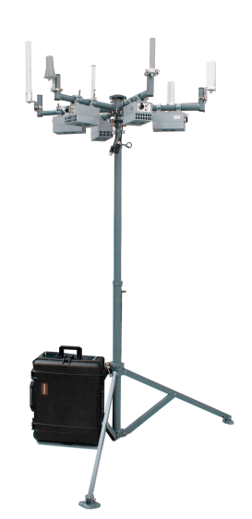
SIMAD 1
MULTIDIRECTIONAL
CAPABILITIES
AUTOMATIC SUPPRESSION, WHEN THE THREAT ENTERS IN THE PROTECTIVE DOME
NEUTRALIZES MULTIPLES DRONES SIMULTANEOUSLY
3 TO 4 KM RANGE.
ADVANCED SIGNAL INTELLIGENCE ALGORITHMS (SIGINT)
SPECIFICATIONS
MAIN SPECIFICATIONS | TECHNICAL DATA
Detection range | Does not have a detection system.
Jamming range | Hemispherical area with 1 to 2 Km range.
installation | Fixed or mobile
Object tracking | After the target’s identification.
5 band frequencies (MHz) | 390-490; 850-960; 1200-1606; 2200-2600; e 4900-5900.
Data provideds | Azimuth
Size | Jammer Module: 55 x 51 x 28 cm
 | Control Unit: 59 x 50 x 28 cm
 | Direction Finder Unit: 129 x 125 x 125 cm
 | Tripod: 150 x 140 x 140 cm
Total weight | 80kg
PACKAGE
1 (one) tripod.
Jamming System.
Signal processing unit.
Cables.
Control station with laptop.
Transport cases.

Slide 5
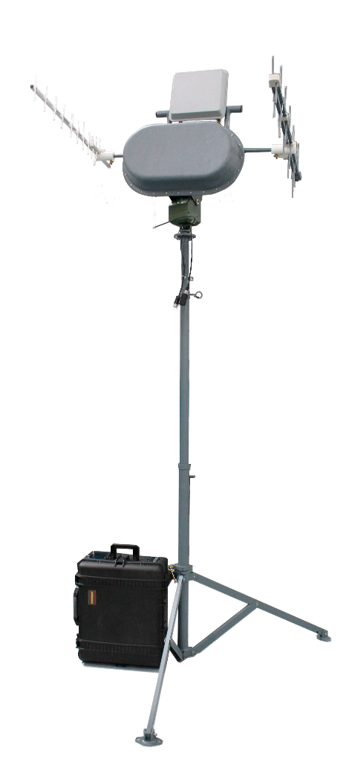
SIMAD 1
unidirectional
CAPABILITIES
DIRECTIONAL JAMMING IN 60° SECTOR.
NEUTRALIZES MULTIPLES DRONES SIMULTANEOUSLY
3 TO 4 KM RANGE.
ADVANCED SIGNAL INTELLIGENCE ALGORITHMS (SIGINT)
SPECIFICATIONS
MAIN SPECIFICATIONS | TECHNICAL DATA
Detection range | Does not have a detection system.
 | The operator needs to identify the drone.
Jamming range | 60º section with 3 to 4 Km range.
installation | Fixed or mobile
Object tracking | After the target’s identification.
5 band frequencies (MHz) | 390-490; 850-960; 1200-1606; 2200-2600; e 4900-5900.
Data provided | Azimuth
Size | Jammer Module: 55 x 51 x 28 cm
 | Control Unit: 59 x 50 x 28 cm
 | Direction Finder Unit: 129 x 125 x 125 cm
 | Tripod: 150 x 140 x 140 cm
Total weight | 87kg

Slide 6
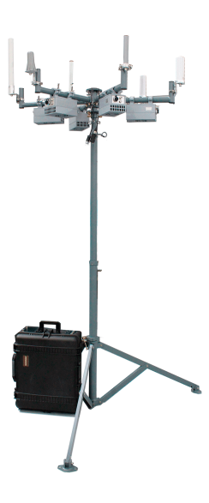
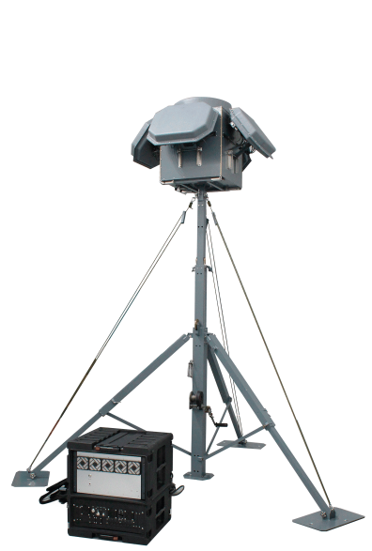
SIMAD 2
AUTOMATIC JAMMING AFTER DETECTION.
NEUTRALIZES MULTIPLE DRONES SIMULTANEOUSLY.
RANGE OF 3 to 4 KM.
ADVANCED SIGNAL INTELLIGENCE ALGORITHMS (SIGINT).
EFFECTIVE USE OF THE ELECTROMAGNETIC SPECTRUM.
RECORD OF DETECTION.
CROSSING INFORMATION WITH DATABASE.
ULTRAWIDE BAND DETECTION SYSTEM.
DETECTION & JAMMING
Detection range | - Small Drone: 2-3 km.
Jamming range | - It is activated as soon as the drone is detected.
 | - With the direction determined, the unidirectional system is activated.
 | - Range of 3 to 4 km.
 | Fixed or mobile.
Object tracking | The systems work together and are fully automated.
Operation frequency (MHz) | 390-490; 850-960; 1200-1606; 2200-2600; e 4900-5900
 | Detection & Direction Finder System | Jamming System
Size | Process unit: 51 x 56 x 38 cm | Jammer Module: 55 x 51 x 28 cm
 | RF Module: 86 x 86 x 75 cm | Control Unit: 59 x 50 x 28 cm
 | Tripod: 340 x 260 x 260 cm | Direction Finder Unit: 129 x 125 x 125 cm
 |  | Tripod: 150 x 140 x 140 cm
Total weight | 147 kg | 87 kg
PACKAGE
2 (two) tripods.
Signal processing unit.
Detection System.
Jamming System.
2 (two) sets of cables.
2 (two) control stations with laptop.
2 (two) sets of transport cases.

Slide 7
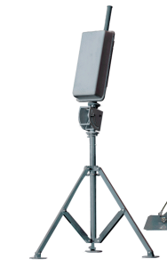
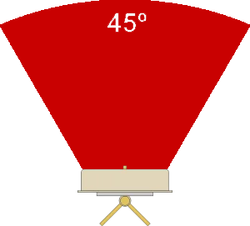
‘ATALAIA’ RADAR
(ACTIVE DETECTION)
RADAR 20
Operating frequency range | C-Band
Operative mode | Monopulse Doppler radar
Detection range (Radar 20) | 100-5.000 m
Power consumption | 300W
Size | Radar: 36 cm × 72,5 cm × 18 cm
 | Tripod: 120x 60 cm
Total weight | 25 kilos
RADAR 200
Operating frequency range | C-Band
Operative mode | Monopulse Doppler radar
Detection range (Radar 200) | 5.000-10.000 m
Power consumption | 300W
Size | Radar: 36 cm × 72,5 cm × 18 cm
 | Tripod: 120x 60 cm
Total weight | 25 kilos
The Atalaia Radar has a circular cover- age sector of 45º. In this way, the com- bination of 8 units allows covering a 360º sector.

Slide 8
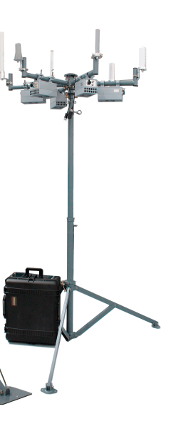
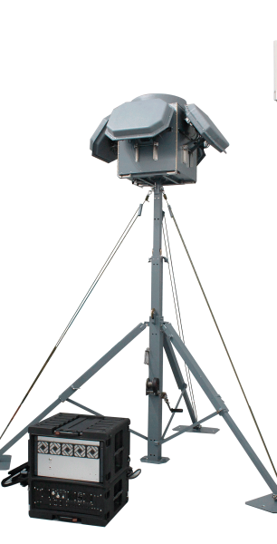
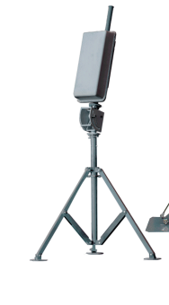
SIMAD 3
omnidirectional
AUTOMATIC JAMMING AFTER DETECTION.
NEUTRALIZES MULTIPLE DRONES SIMULTANEOUSLY.
RANGE OF 1 to 2 KM.
ADVANCED SIGNAL INTELLIGENCE ALGORITHMS (SIGINT).
EFFECTIVE USE OF THE ELECTROMAGNETIC SPECTRUM.
RECORD OF DETECTION.
CROSSING INFORMATION WITH DATABASE.
ULTRAWIDE BAND DETECTION SYSTEM.
DETECTION & JAMMING
Detection range | - Drone: 5 km.
 | - Medium-sized drones: 50 km.
 | - Large drones: 200 km.
Jamming range | - It is activated as soon as the drone is detected.
 | - With the direction determined, the unidirectional system is activated.
 | - Range of 1-2 km.
installation | Fixed or mobile.
Object tracking | The systems work together and are fully automated.
Operation frequency (MHz) | 390-490; 850-960; 1200-1606; 2200-2600; e 4900-5900
 | Detection & Direction Finder System | Jamming System
Size | Process unit: 51 x 56 x 38 cm | Jammer Module: 55 x 51 x 28 cm
 | RF Module: 86 x 86 x 75 cm | Control Unit: 59 x 50 x 28 cm
 | Tripod: 340 x 260 x 260 cm | Direction Finder Unit: 129 x 125 x 125 cm
 |  | Tripod: 150 x 140 x 140 cm
Total weight | 147 kg | 87 kg
RADAR
Operating frequency range | C-Band
Operative mode | Monopulse Doppler radar
Detection range (Radar 20) | 100-3.000 m
Detection range (Radar 200) | 5.000-10.000 m
Power consumption | 300W
Size | Radar: 36 cm × 72,5 cm × 18 cm
 | Tripod: 120x 60 cm
Total weight | 25 kilos
PACKAGE
3 (three) tripods.
Suppression System.
Signal processing unit.
Detection System.
Radar (from 1 to 8 units) *;
3 (three) sets of cables.
3 (three) control stations with laptop.
3 (three) sets of transport cases; It is
1 (one) amplifier module (optional).

Slide 9
SIMAD 3
unidirectional
AUTOMATIC JAMMING AFTER DETECTION.
NEUTRALIZES MULTIPLE DRONES SIMULTANEOUSLY.
RANGE OF 3 to 4 KM.
ADVANCED SIGNAL INTELLIGENCE ALGORITHMS (SIGINT).
EFFECTIVE USE OF THE ELECTROMAGNETIC SPECTRUM.
RECORD OF DETECTION.
CROSSING INFORMATION WITH DATABASE.
ULTRAWIDE BAND DETECTION SYSTEM.
DETECTION & JAMMING
Detection range | - Drone: 5 km.
 | - Medium-sized drones: 50 km.
 | - Large drones: 200 km.
Jamming range | - It is activated as soon as the drone is detected.
 | - With the direction determined, the unidirectional system is activated.
 | - Range of 3-4 km.
installation | Fixed or mobile.
Object tracking | The systems work together and are fully automated.
Operation frequency (MHz) | 390-490; 850-960; 1200-1606; 2200-2600; e 4900-5900
 | Detection & Direction Finder System | Jamming System
Size | Process unit: 51 x 56 x 38 cm | Jammer Module: 55 x 51 x 28 cm
 | RF Module: 86 x 86 x 75 cm | Control Unit: 59 x 50 x 28 cm
 | Tripod: 340 x 260 x 260 cm | Direction Finder Unit: 129 x 125 x 125 cm
 |  | Tripod: 150 x 140 x 140 cm
Total weight | 147 kg | 87 kg
RADAR
Operating frequency range | C-Band
Operative mode | Monopulse Doppler radar
Detection range (Radar 20) | 100-3.000 m
Detection range (Radar 200) | 5.000-10.000 m
Power consumption | 300W
Size | Radar: 36 cm × 72,5 cm × 18 cm
 | Tripod: 120x 60 cm
Total weight | 25 kilos
PACKAGE
3 (three) tripods.
Suppression System.
Signal processing unit.
Detection System.
Radar (from 1 to 8 units) *;
3 (three) sets of cables.
3 (three) control stations with laptop.
3 (three) sets of transport cases; It is
1 (one) amplifier module (optional).

Slide 10
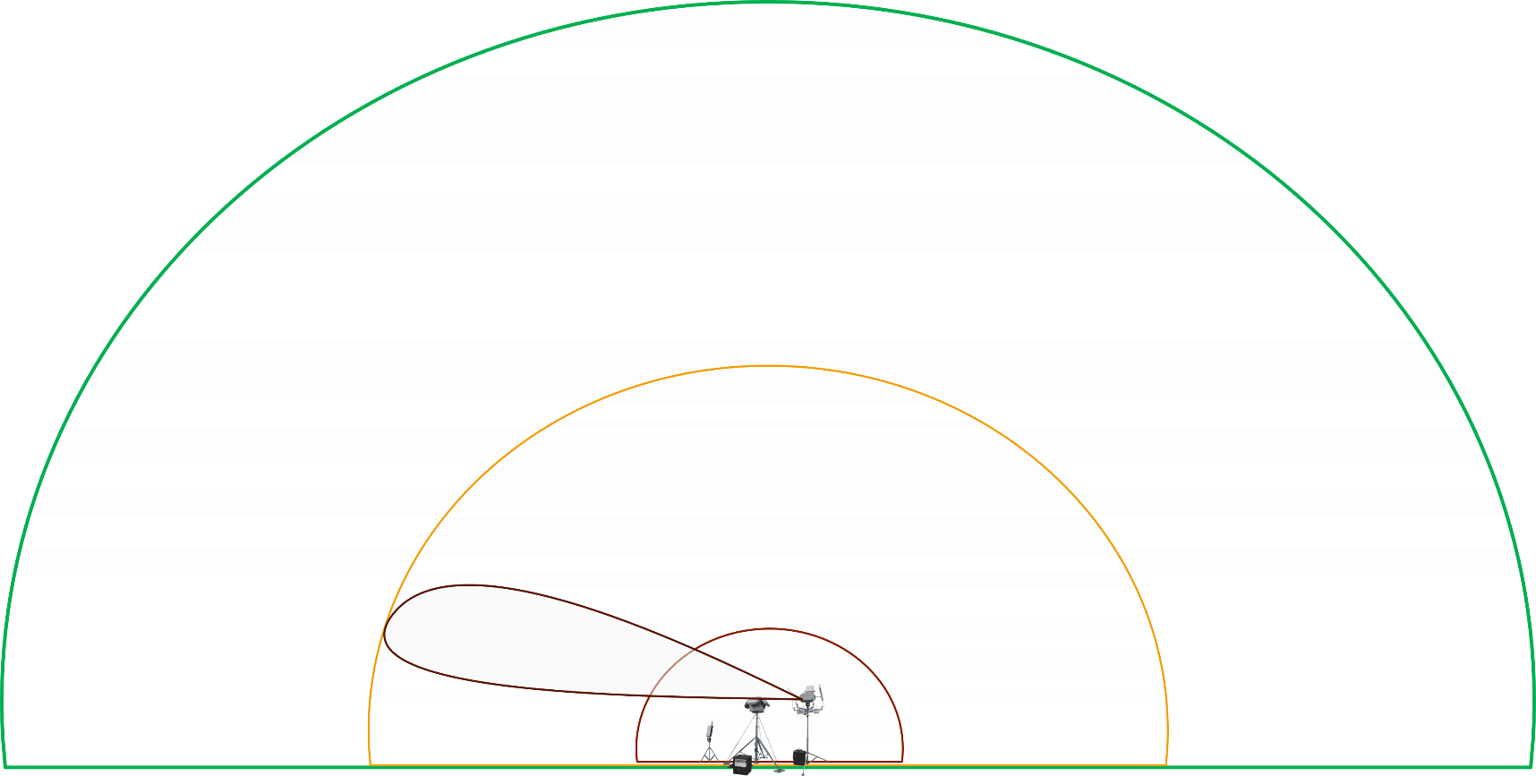
3D SPATIAL COVERAGE
Radar 20 (active detection of small drones at 5km)
3.000m
(passive detection)
Unidirectional (3 sq.km)
Omnidirectional (1 sq.km)

Slide 11
Coverage over Hargeisa
DETECTION RANGE
- Drone: 5 km.
- Medium-sized drones: 50 km.
- Large drones: 200 km.
JAMMING RANGE
- It is activated as soon as the drone is detected.
- With the direction determined, the unidirectional system is activated with a range of 3-4 km.
Jamming 4Km radial range
Radar 5Km radial range

Slide 12
PRESENTED AND WARRATIED
by
info@aerofoundry.com
aerofoundry.com

